Slide 1


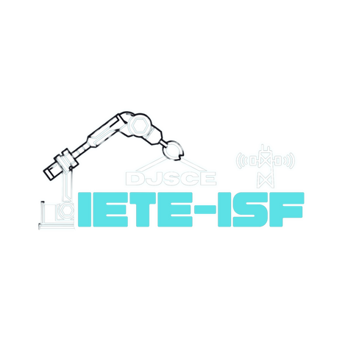







DEPARTMENT OF ELECTRONICS & TELECOMMUNICATION ENGINEERING
PRESENTS
2.0
A 24-HOUR HARDWARE HACKATHON
POWERED BY
ROUND 2

Slide 2

2.0
Team Name: Erga Labs
A 24-HOUR HARDWARE HACKATHON
Nishumbh Shah (Team Leader) – DY Patil University
Tejas Bhovad - DY Patil University
Pranavi Shukla - DY Patil University
Satish Singh - DY Patil University
Dev Tangadi - DY Patil University
Hamza Murghay - DY Patil University

Slide 3

Problem Statement Overview
2.0
A 24-HOUR HARDWARE HACKATHON
Smart City framework
Title: Real-Time Urban Management System
Problem Statement
Modern urban areas face escalating challenges related to environmental degradation, safety concerns, and inefficient resource management. These issues not only compromise the quality of life but also hinder economic growth and sustainability. Traditional methods of environmental monitoring and public safety management are often fragmented and inefficient, leading to delayed responses and suboptimal resource utilization.
Objective
To develop an integrated Internet of Things (IoT) hardware solution, the Smart City Environmental Sentinel, designed to revolutionize urban environmental monitoring, public safety, and resource management. This system aims to leverage advanced sensors, real-time data collection, and interconnected devices to enhance decision-making processes and improve urban living conditions.

Slide 4
Highlighted Problems
2.0
A 24-HOUR HARDWARE HACKATHON
Key Issues:
1. Environmental Domain
Air Quality Degradation:
High levels of particulate matter and harmful gases negatively impact public health.
Real-time monitoring using dust and gas sensors.
Noise Pollution:
Excessive noise levels affect public health and quality of life.
Continuous monitoring with the Sound Sensor Module.
Temperature and humidity extremes:
Uncomfortable living conditions due to extreme temperatures and humidity levels.
Monitoring with BME280 and DHTII sensors.
Water Management Inefficiencies:
Inefficient water usage and potential leaks waste resources and cause environmental damage.
Real-time monitoring with a water flow sensor.
[Team Name]:

Slide 5
Highlighted Problems
2.0
A 24-HOUR HARDWARE HACKATHON
2. Public Safety Domain
Delayed Fire Detection:
Slow fire detection increases the risk of property damage and safety threats.
Early detection using an IR flame sensor.
Slow Emergency Response Times:
Delayed responses to emergencies compromise public safety.
Automated alerts and real-time data for faster emergency response.
3. Energy and Sustainability Domain
Inefficient Energy Consumption:
High energy consumption and reliance on non-renewable sources contribute to environmental degradation.
Sustainable power management using Solar Panels and rechargeable batteries.
4. Data Management and Decision-Making Domain
Data Fragmentation and Delayed Decision-Making:
Disparate data sources and slow data processing hinder effective decision-making.
Integrated data collection and real-time transmission using ESP32.
[Team Name]:

Slide 6
Highlighted Problems
2.0
A 24-HOUR HARDWARE HACKATHON
5. Infrastructure and Scalability Domain
Inflexible Infrastructure and Scalability Limitations:
Difficulty in adding new components or expanding the system limits its potential.
Modular design allows for easy integration of additional components and scalability.
6. Economic and Quality of Life Domain
Economic Inefficiencies and Decreased Quality of Life:
High maintenance costs and environmental degradation negatively impact residents' well-being and economic growth.
Efficient resource management, reduced maintenance needs, and improved environmental conditions enhance quality of life and support sustainable economic development.
[Team Name]:

Slide 7
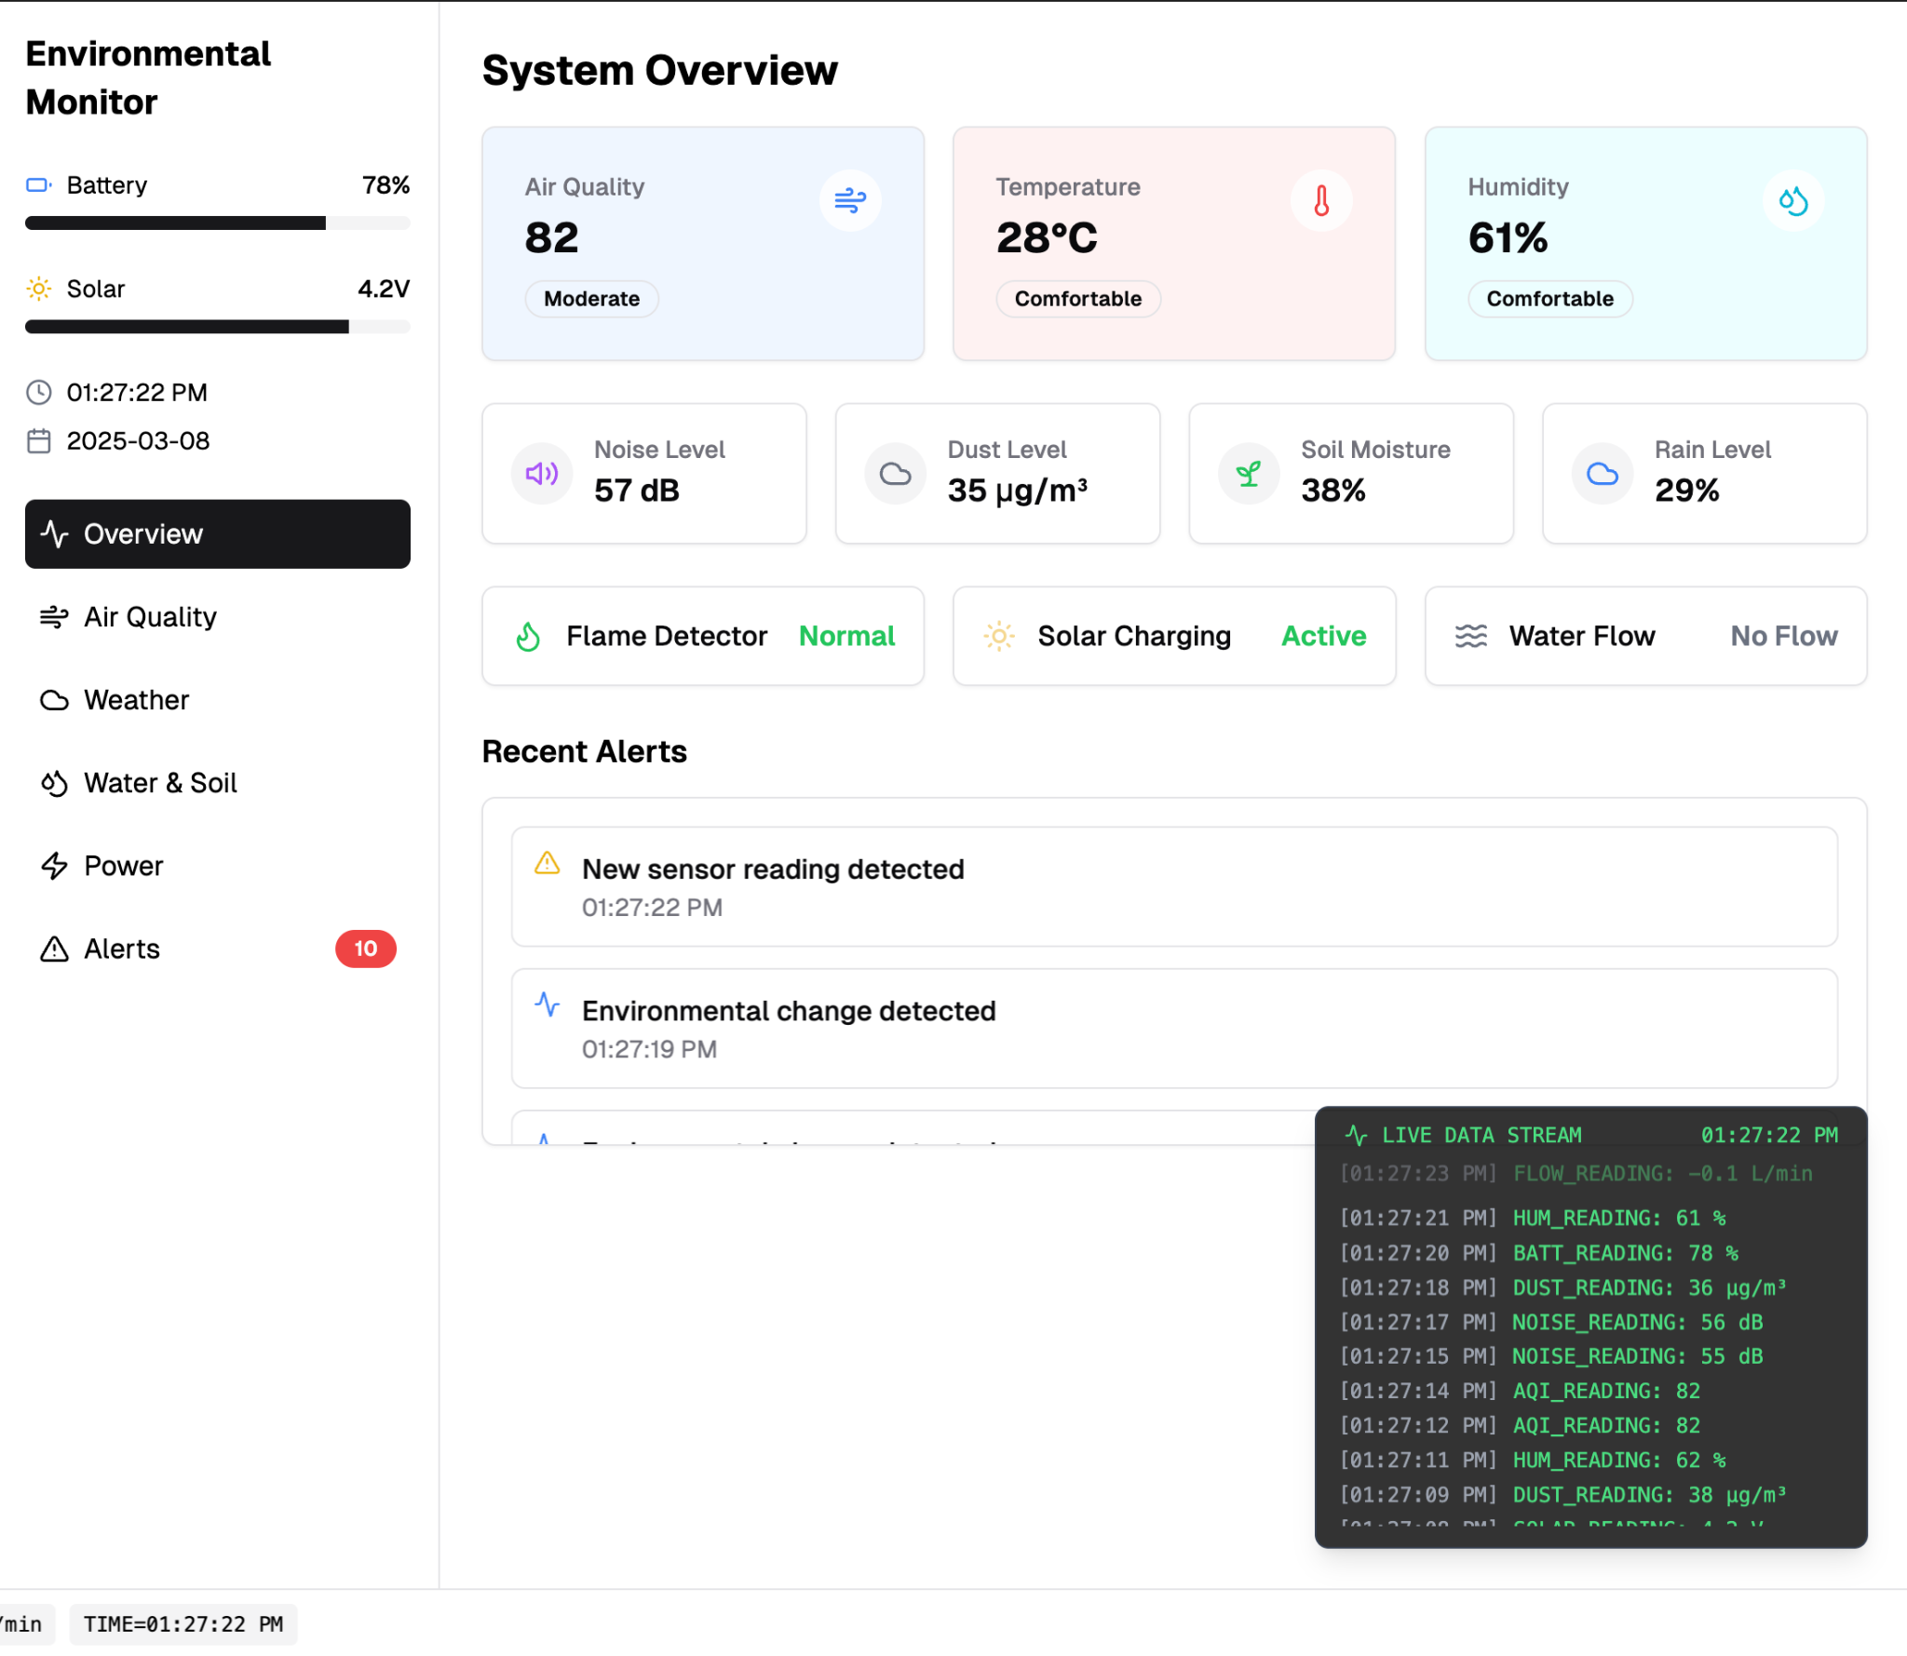
2.0
A 24-HOUR HARDWARE HACKATHON
Our Smart City Environmental Sentinel Dashboard offers real-time insights into safety, energy, traffic, and air quality, etc empowering data-driven urban planning. This comprehensive platform enhances sustainability and livability through actionable analytics.
[Team Name]:

Slide 8
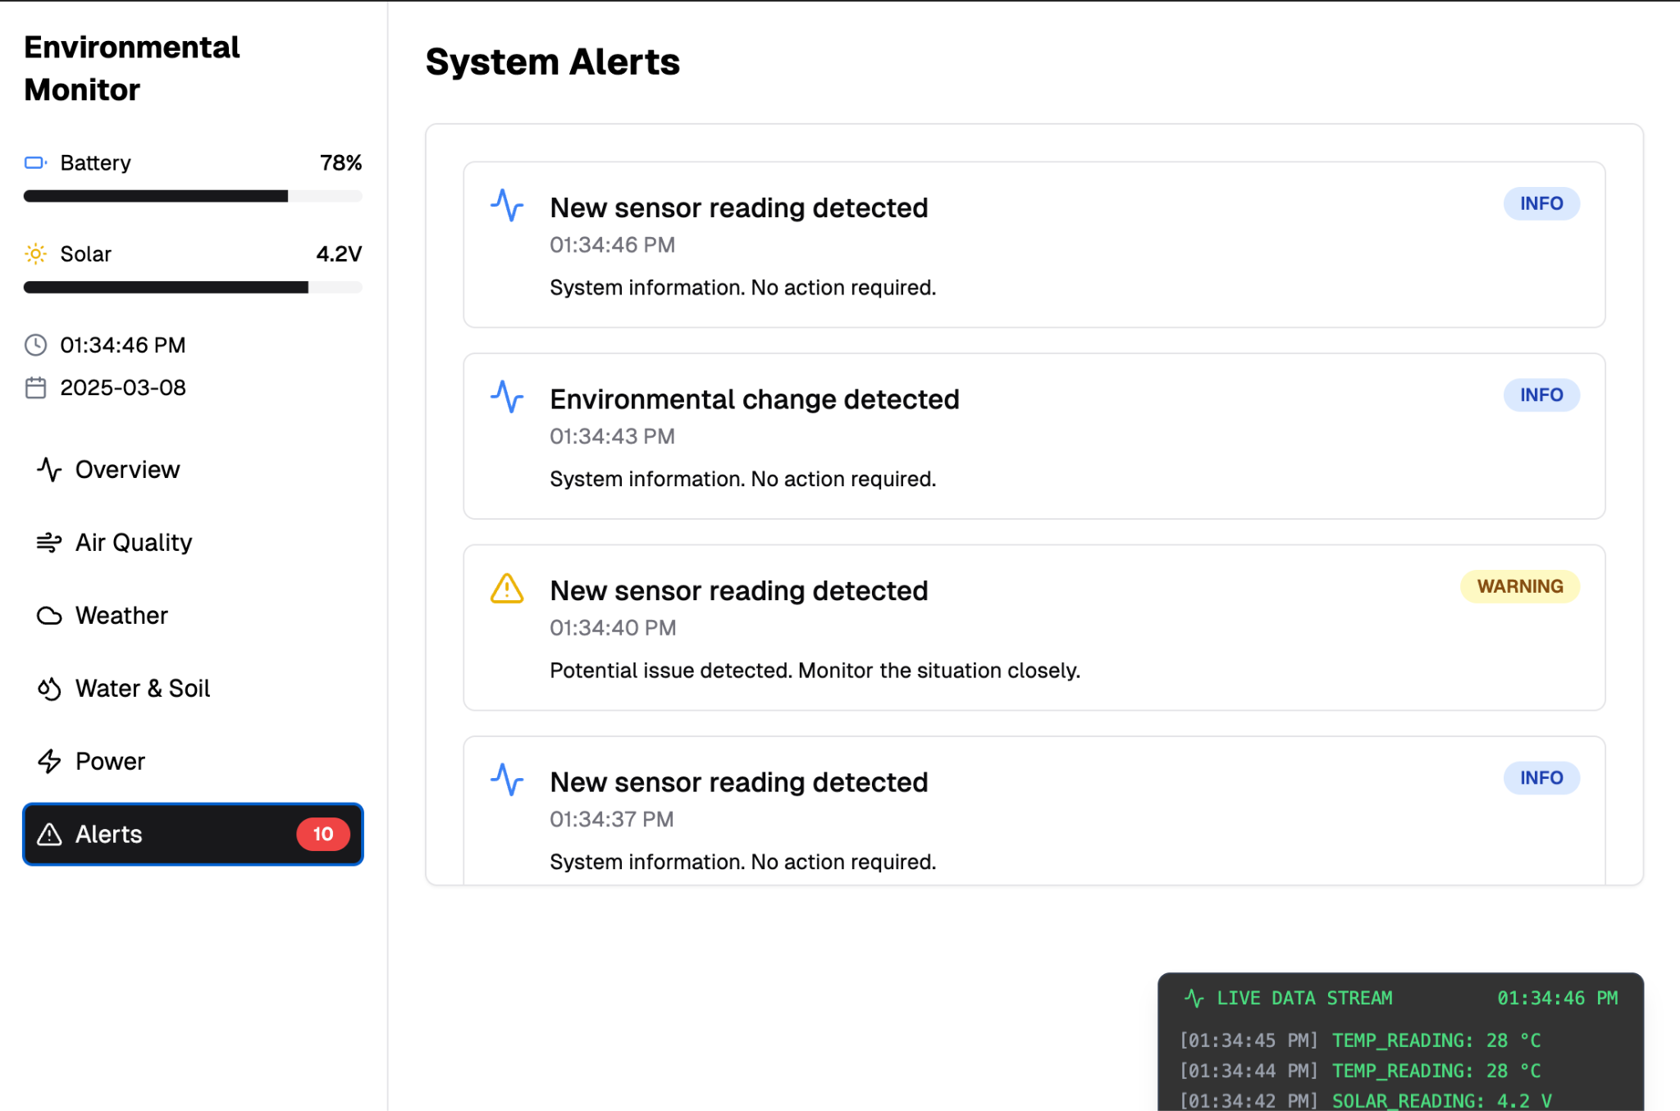
Alert Page delivers instant notifications for critical events, ensuring swift responses to safety threats and environmental hazards.

Slide 9
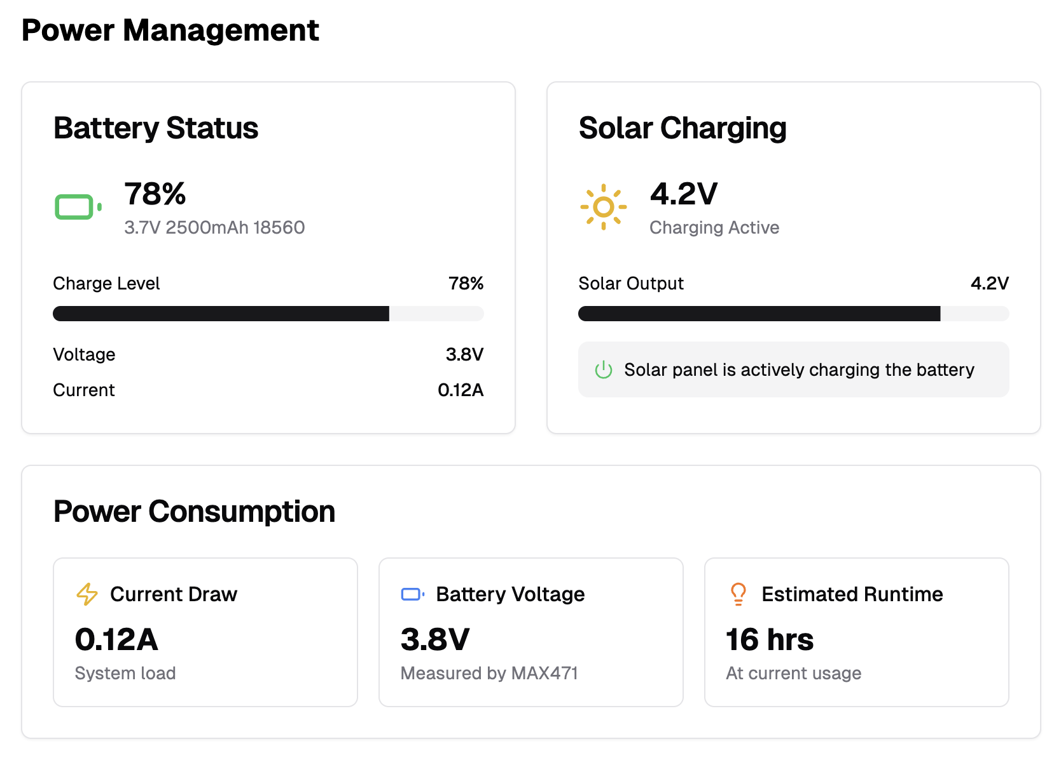
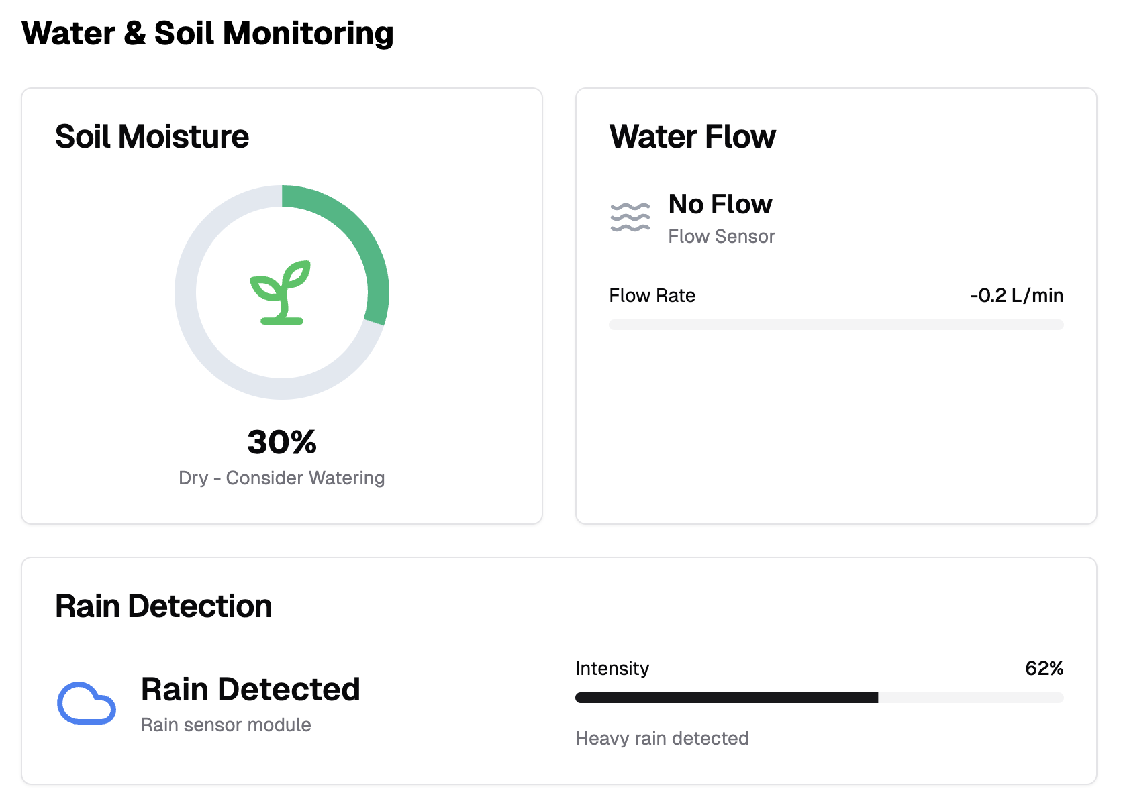
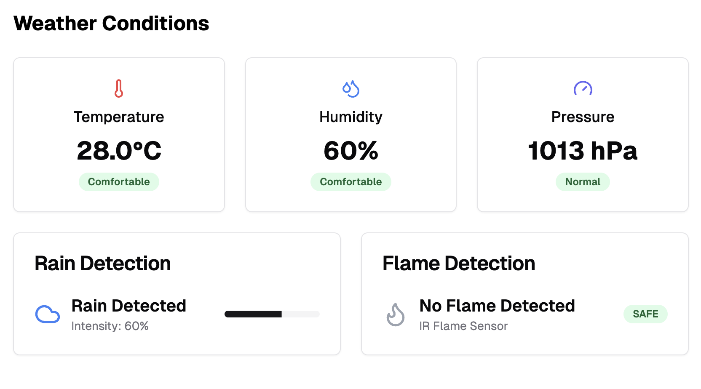
Each parameter in our Smart City Environmental Sentinel has a dedicated page, providing in-depth insights and real-time monitoring for comprehensive understanding and management of urban challenges.

Slide 10
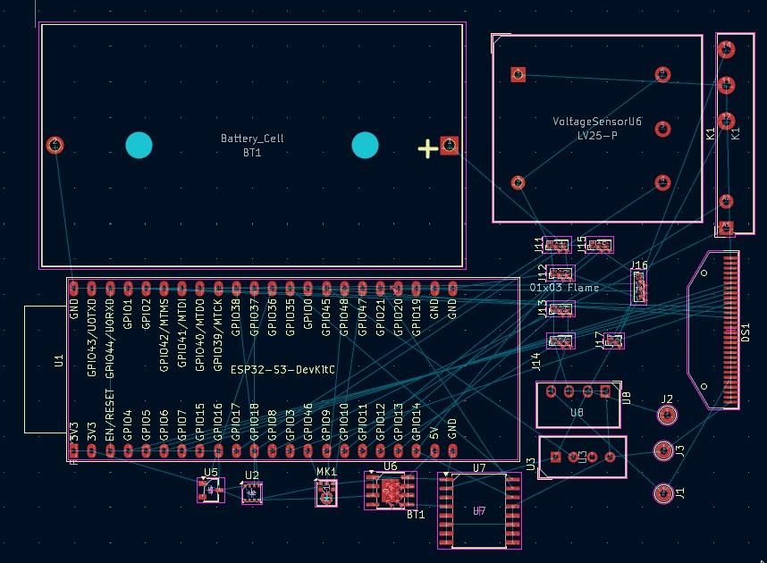
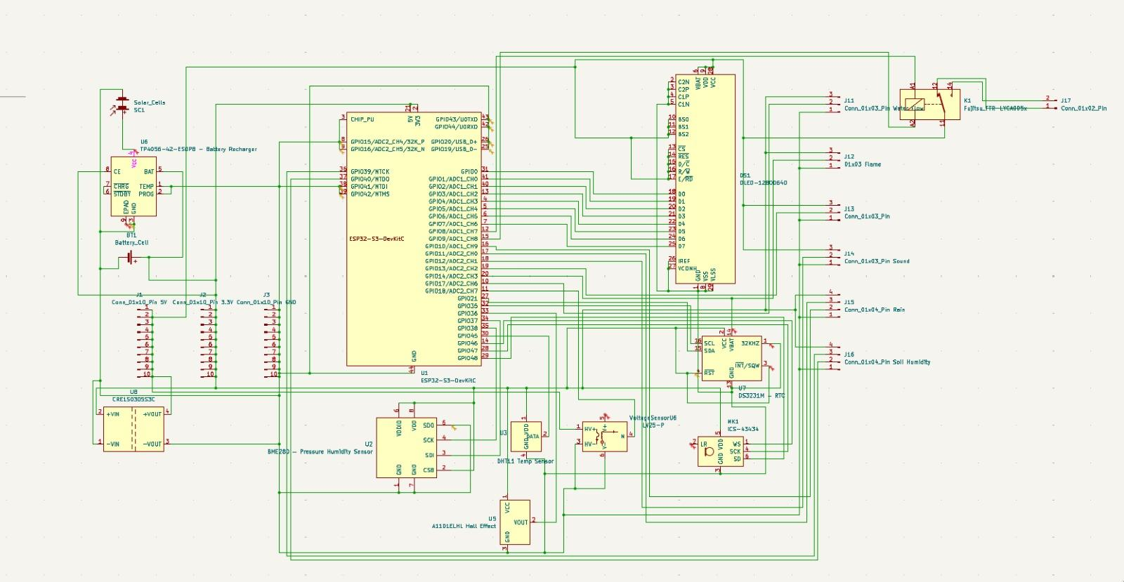
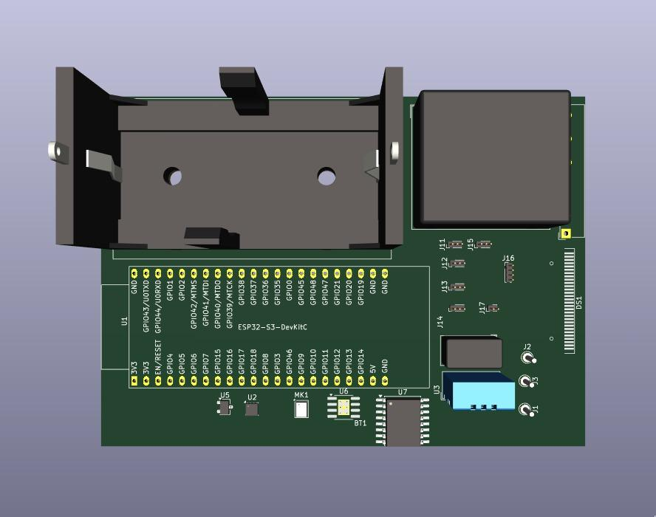
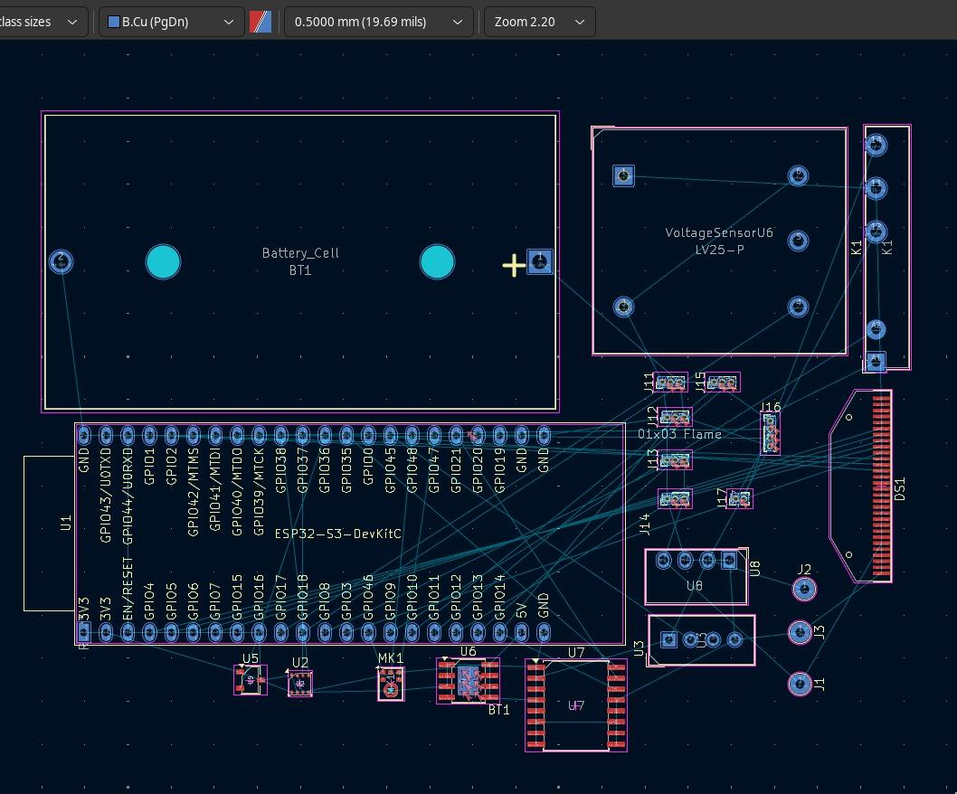
Technical Approach
2.0
A 24-HOUR HARDWARE HACKATHON
[Team Name]:

Slide 11
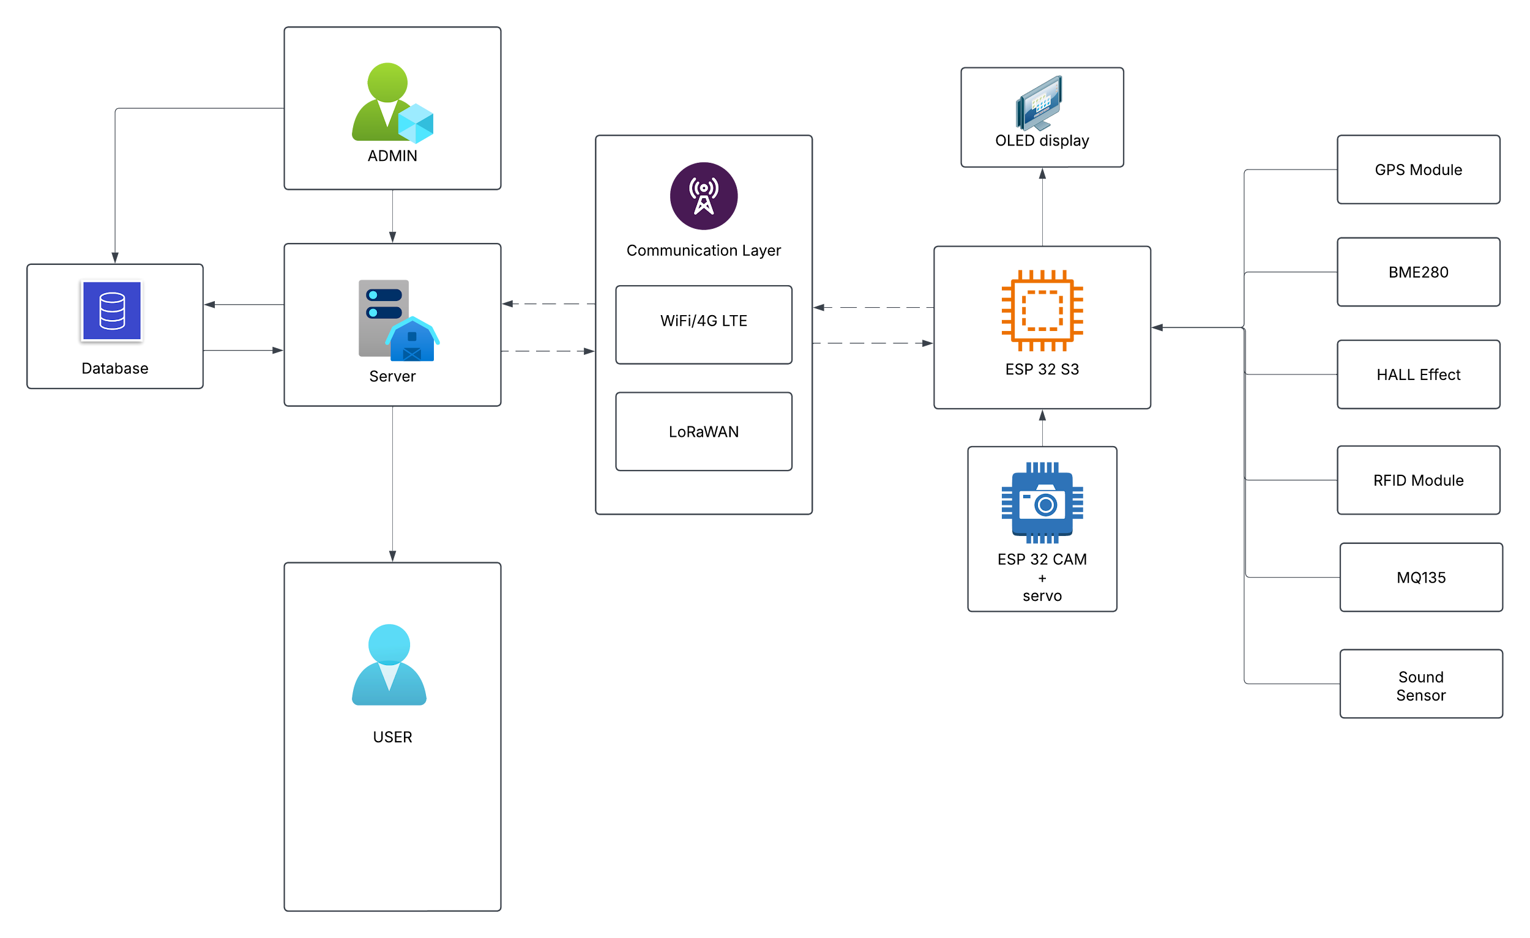
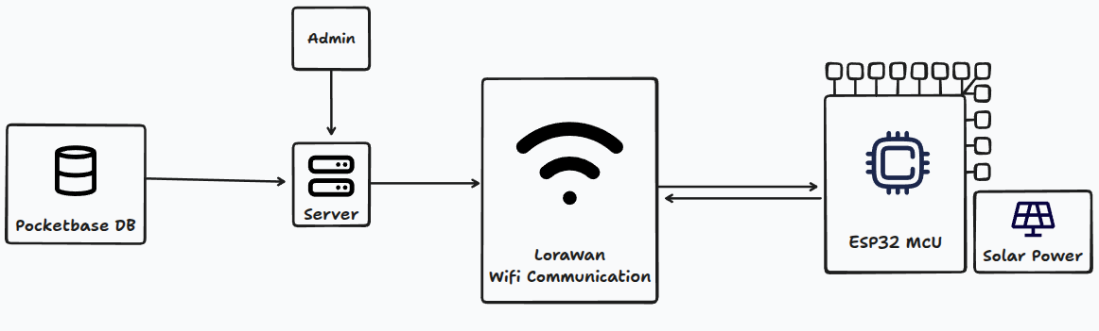
System Architecture
2.0
A 24-HOUR HARDWARE HACKATHON

Slide 12
Impact and Benefits
2.0
A 24-HOUR HARDWARE HACKATHON
1. Environmental Sustainability
Impact: Reduces pollution and environmental degradation by monitoring air quality, noise levels, and water usage.
Benefit: Improves public health and enhances urban ecosystems through real-time data-driven interventions.
2. Public Safety and Emergency Response
Impact: Enhances emergency response times through real-time monitoring and alerts.
Benefit: Saves lives and reduces property damage by enabling swift action during emergencies like fires.
3. Energy Efficiency and Sustainability
Impact: Promotes sustainable energy use by leveraging solar power and efficient power management.
Benefit: Reduces greenhouse gas emissions and operational costs, contributing to a more sustainable urban environment.
4. Data-Driven Decision Making and Infrastructure Optimization
Impact: Provides real-time data for informed urban planning and resource allocation.
Benefit: Improves service delivery and reduces waste by optimizing resource use, enhancing infrastructure efficiency, and supporting predictive maintenance.
5. Economic Benefits and Quality of Life Improvements
Impact: Enhances economic growth by supporting sustainable urban development and reducing operational costs.
Benefit: Improves residents' quality of life through better environmental conditions, enhanced public safety, and more efficient public services, leading to increased citizen satisfaction and engagement.
[Team Name]:

